Slide 1
Global Professional Services Industry MI
Corporate Research Desk
TCS Internal
November, 2014

Slide 2
Table of Content
Global Professional Services MI
Market Overview
Industry Insights
Deals Space
Business Trends
Technology Trends
Top Players
Disclaimer:
The information presented in this report is based on data available in the public domain. If you find that it is incorrect, please let us know.

Slide 3
Table of Content
Global Professional Services MI
Market Overview
Disclaimer:
The information presented in this report is based on data available in the public domain. If you find that it is incorrect, please let us know.

Slide 4
Global Professional Services Industry: Market Overview Accounting Services
Market Value
The accountancy market consists of revenues generated by firms engaged in designing, preparing and auditing accounting records. Income from tax, auditing, and advisory service provision is included. For Japan, the market covers certified public accountant firms only. Any currency conversions used in the creation of this report have been calculated using constant 2012 annual average exchange rates.
Year | $ billion | % Growth
2008 | 355.8
2009 | 350.7 | (1.4%)
2010 | 362.3 | 3.3%
2011 | 382.1 | 5.5%
2012 | 396.0 | 3.6%
CAGR |  | 2.7%
Category Segmentation
Category | $ billion | Market Share(%)
Audit | 174.2 | 44
Advisory | 130.7 | 33
Tax | 91.2 | 23
Total | 396.1
Geographic Segmentation
Geography | $ billion (2012) | Market Share(%)
Americas | 191.3 | 48.3
Europe | 125.9 | 31.8
Asia-Pacific | 68.5 | 17.3
Middle East & Africa | 10.3 | 2.6
Total | 396
Notes:
Marketline-2013

Slide 5
Global Professional Services Industry: Market Overview Accounting Services
Market Value Forecast
Year | $ billion | Growth(%)
2012 | 396 | 3.6
2013 | 413 | 4.3
2014 | 433.1 | 4.9
2015 | 455.7 | 5.2
2016 | 480.4 | 5.4
2017 | 507.7 | 5.7
CAGR 2012-17 |  | 5.1
Top Players
Company | Revenue(2012) | Growth
PwC | $26.57 Billion | 8.82%
Deloitte | $31.3Bn | 8.7%
Ernst & Young | $24.4Bn | NA
KPMG | $23Bn | 1.32

Slide 6
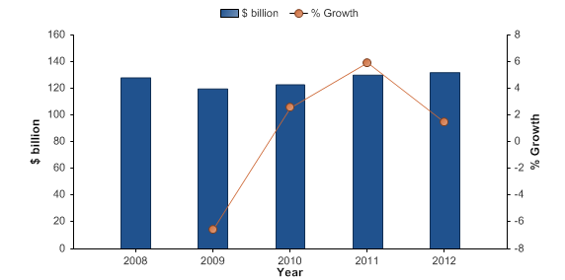
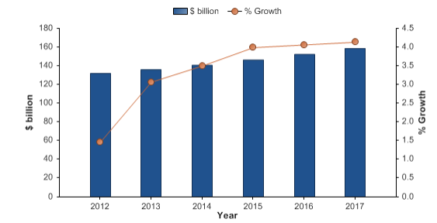
Global Professional Services Industry: Market Overview US Accounting Services
Market Value
The US accountancy market had total revenues of $132.0bn in 2012, representing a compound annual growth rate (CAGR) of 0.7% between 2008 and 2012. The audit segment was the market's most lucrative in 2012, with total revenues of $57.6bn, equivalent to 43.7% of the market's overall value. The advisory segment contributed revenues of $40.0bn in 2012, equating to 30.3% of the market's aggregate value.
Year | $ billion | % Growth
2008 | 128.1
2009 | 119.7 | (6.5%)
2010 | 122.8 | 2.6%
2011 | 130.1 | 5.9%
2012 | 132.0 | 1.5%
CAGR
Market Value Forecast
The performance of the market is forecast to accelerate, with an anticipated CAGR of 3.7% for the five-year period 2012 - 2017, which is expected to drive the market to a value of $158.6bn by the end of 2017.
Year | $ billion | Growth(%)
2012 | 132.0 | 1.5%
2013 | 136.0 | 3.1%
2014 | 140.8 | 3.5%
2015 | 146.4 | 4.0%
2016 | 152.3 | 4.1%
2017 | 158.6 | 4.1%
CAGR 2012-17

Slide 7
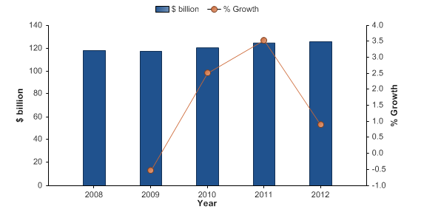
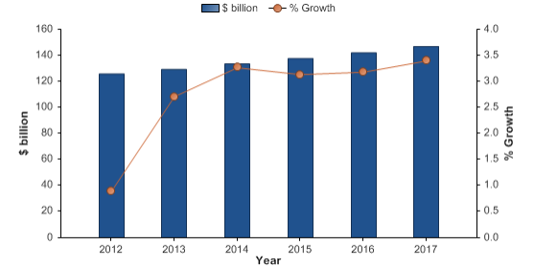
Global Professional Services Industry: Market Overview Europe Accounting Services
Market Value
The European accountancy market had total revenues of $125.9bn in 2012, representing a CAGR of 1.6% between 2008 and 2012. In comparison, the German market declined with a CARC of -0.5%, and the UK market increased with a CAGR of 1.7%, over the same period, to reach respective values of $9.0bn and $30.2bn in 2012.The UK is the largest market in Europe by a sizable margin, accounting for almost a quarter of the European market value.
Year | $ billion | % Growth
2008 | 118.2
2009 | 117.5 | (.5%)
2010 | 120.5 | 2.5%
2011 | 124.7 | 3.5%
2012 | 125.9 | 0.9%
CAGR
Country | $ billion(2012) | % Share
UK | 30.2 | 24%
France | 14.5 | 11.6%
Germany | 9.0 | 7.2%
Spain | 7.0 | 5.6%
Italy | 5.7 | 4.5%
Rest | 59.4 | 47.2%
Market Value Forecast
The performance of the market is forecast to accelerate, with an anticipated CAGR of 3.1% for the five-year period 2012 - 2017, which is expected to drive the market to a value of $146.9bn by the end of 2017. Comparatively, the German and UK markets will grow with CAGRs of 1.9% and 2% respectively, over the same period, to reach respective values of $9.9bn and $33.4bn in 2017
Year | $ billion | Growth(%)
2012 | 125.9 | .9%
2013 | 129.3 | 2.7%
2014 | 133.5 | 3.3%
2015 | 137.7 | 3.1%
2016 | 142.0 | 3.2%
2017 | 146.9 | 3.4%
CAGR 2012-17 |  | 3.1%

Slide 8
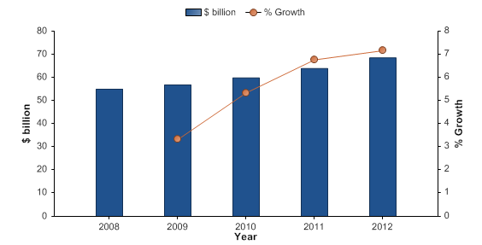
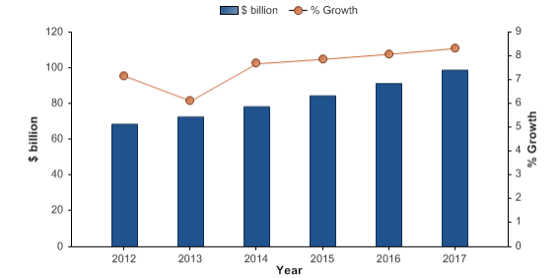
Global Professional Services Industry: Market Overview Asia Pacific Accounting Services
Market Value
The Asia-Pacific accountancy market had total revenues of $68.5bn in 2012, representing CAGR of 5.6% between 2008 and 2012. In comparison, the Chinese market declined with a CAGR of -2.4%, and the South Korean market increased with a CAGR of 11.3%, over the same period, to reach respective values of $3.8bn and $6.6bn in 2012.
Year | $ billion | % Growth
2008 | 55.0
2009 | 56.8 | 3.3%
2010 | 59.9 | 5.3%
2011 | 63.9 | 6.8%
2012 | 68.5 | 7.2%
CAGR |  | 5.6%
Country | $ billion(2012) | % Share
India | 8.5 | 12.3%
South Korea | 6.6 | 9.7%
Japan | 4.9 | 7.1%
China | 3.8 | 5.6%
Rest | 44.7 | 65.3%
Market Value Forecast
The performance of the market is forecast to accelerate, with an anticipated CAGR of 7.6% for the five-year period 2012 - 2017, which is expected to drive the market to a value of $98.8bn by the end of 2017. Comparatively, the Chinese and South Korean markets will grow with CAGRs of 3% and 11.5% respectively, over the same period, to reach respective values of $4.5bn and $11.4bn in 2017.
Year | $ billion | Growth(%)
2012 | 68.5 | 7.2%
2013 | 72.7 | 6.1%
2014 | 78.3 | 7.7%
2015 | 84.4 | 7.9%
2016 | 91.2 | 8.1%
2017 | 98.8 | 8.3%
CAGR 2012-17 |  | 7.6%

Slide 9
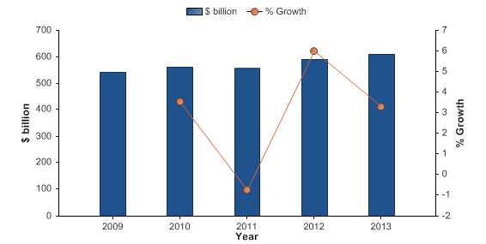
Global Professional Services Industry: Market Overview Legal Services
The global legal services market had total revenues of $610.4bn in 2013, representing a compound annual growth rate (CAGR) of 3% between 2009 and 2013. In comparison, the European and Asia-Pacific markets grew with CAGRs of 3.2% and 5.9% respectively, over the same period, to reach respective values of $184.5bn and $80.4bn in 2013.
Market Value
Year | $ billion | % Growth
2009 | 542.4
2010 | 561.5 | 3.5%
2011 | 557.4 | (.7%)
2012 | 590.8 | 6.0%
2013 | 610.4 | 3.3%
CAGR |  | 3.0%
Geography wise Market value
Region | $ billion(2013) | % Share
Americas | 336.9 | 55.2%
Europe | 184.5 | 30.2%
Asia Pacific | 80.4 | 13.2%
Mid East & Africa | 8.6 | 1.4%
Notes:
Marketline-2012

Slide 10
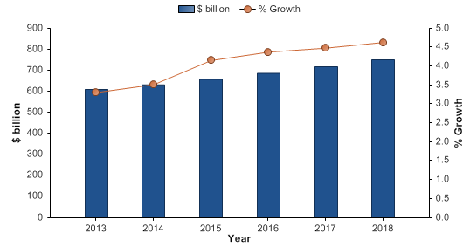
Global Professional Services Industry: Market Overview Legal Services
Market Forecast
The performance of the market is forecast to accelerate, with an anticipated CAGR of 4.2% for the five-year period 2013 - 2018, which is expected to drive the market to a value of $750.9bn by the end of 2018. Comparatively, the European and Asia-Pacific markets will grow with CAGRs of 3.6% and 7% respectively, over the same period, to reach respective values of $220.2bn and $112.9bn in 2018.
Year | $ billion | Growth(%)
2013 | 610.4 | 3.3%
2014 | 631.8 | 3.5%
2015 | 654.1 | 4.2%
2016 | 686.9 | 4.4%
2017 | 717.7 | 4.5%
2018 | 750.9 | 4.6%
CAGR 2013-18 |  | 4.2%

Slide 11
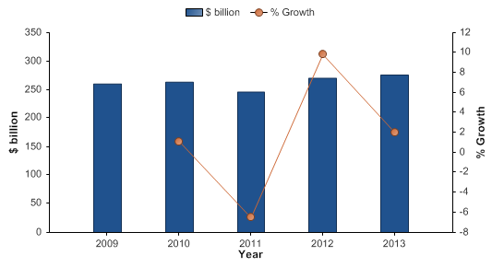
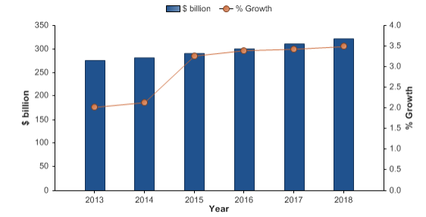
Global Professional Services Industry: Market Overview US Legal Services
Market Value
The US legal services market had total revenues of $275.8bn in 2013, representing a compound annual growth rate (CAGR) of 1.4% between 2009 and 2013. $80.4bn in 2013.
Year | $ billion | % Growth
2009 | 260.5
2010 | 263.4 | 1.1%
2011 | 246.2 | (6.5%)
2012 | 270.4 | 9.8%
2013 | 275.8 | 2.0%
CAGR |  | 1.4%
Market Forecast
The performance of the market is forecast to accelerate, with an anticipated CAGR of 3.1% for the five-year period 2013 - 2018, which is expected to drive the market to a value of $321.9bn by the end of 2018.
Year | $ billion | Growth(%)
2013 | 275.8 | 2.0%
2014 | 281.7 | 2.1%
2015 | 290.9 | 3.3%
2016 | 300.8 | 3.4%
2017 | 311.1 | 3.4%
2018 | 321.9 | 3.5%
CAGR 2013-18 |  | 3.1%

Slide 12
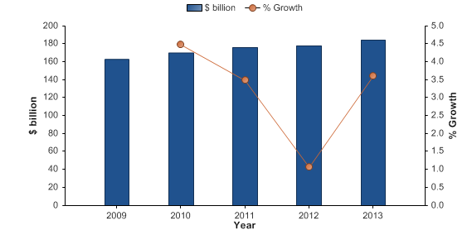
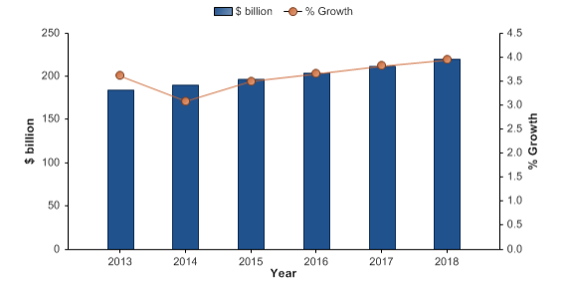
Global Professional Services Industry: Market Overview Europe Legal Services
Market Value
The European legal services market had total revenues of $184.5bn in 2013, representing a compound annual growth rate (CAGR) of 3.2% between 2009 and 2013. In comparison, the German and UK markets grew with CAGRs of 2.3% and 4.7% respectively, over the same period, to reach respective values of $26.0bn and $45.8bn in 2013.
Year | $ billion | % Growth
2009 | 162.9
2010 | 170.2 | 4.5%
2011 | 176.2 | 3.5%
2012 | 178.0 | 1.1%
2013 | 184.5 | 3.6%
CAGR |  | 3.2%
Country | $ billion(2013) | % Share
UK | 45.8 | 24.8%
France | 27.9 | 15.1%
Germany | 26.0 | 14.1%
Italy | 25.0 | 13.5%
Spain | 12.2 | 6.6%
Rest | 47.6 | 25.8%
Market Forecast
The performance of the market is forecast to accelerate, with an anticipated CAGR of 3.6% for the five-year period 2013 - 2018, which is expected to drive the market to a value of $220.2bn by the end of 2018. Comparatively, the German and UK markets will grow with CAGRs of 4% and 3% respectively, over the same period, to reach respective values of $31.6bn and $53.0bn in 2018
Year | $ billion | Growth(%)
2013 | 184.5 | 3.6%
2014 | 190.2 | 3.1%
2015 | 196.8 | 3.5%
2016 | 204.0 | 3.7%
2017 | 211.8 | 3.8%
2018 | 220.2 | 3.9%
CAGR 2013-18 |  | 3.6%

Slide 13
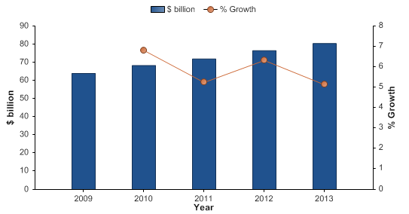

Global Professional Services Industry: Market Overview Asia-Pacific Legal Services
Market Value
The Asia-Pacific legal services market had total revenues of $80.4bn in 2013, representing a compound annual growth rate (CAGR) of 5.9% between 2009 and 2013. In comparison, the Japanese market declined with a compound annual rate of change (CARC) of -4.6%, and the Chinese market increased with a CAGR of 8.6%, over the same period, to reach respective values of $3.7bn and $35.7bn in 2013.
Year | $ billion | % Growth
2009 | 64.0
2010 | 68.3 | 6.8%
2011 | 71.9 | 5.2%
2012 | 76.4 | 6.3%
2013 | 80.4 | 5.1%
CAGR
Country | $ billion(2013) | % Share
India | 8.7 | 10.9%
South Korea | 4.9 | 6.1%
Japan | 3.7 | 4.6%
China | 35.7 | 44.5%
Rest | 27.3 | 34.0%
Market Forecast
The performance of the market is forecast to accelerate, with an anticipated CAGR of 7% for the five-year period 2013 -2018, which is expected to drive the market to a value of $112.9bn by the end of 2018. Comparatively, the Japanese market will decline with a CARC of -1.5%, and the Chinese market will increase with a CAGR of 8.8%, over the same period, to reach respective values of $3.4bn and $54.5bn in 2018.
Year | $ billion | Growth(%)
2013 | 80.4 | 5.1%
2014 | 85.9 | 6.9%
2015 | 91.7 | 6.7%
2016 | 98.2 | 7.1%
2017 | 105.2 | 7.1%
2018 | 112.9 | 7.1%
CAGR 2013-18 |  | 7.0%

Slide 14
Global Professional Services Industry: Market Overview Management & Marketing Services
The value of the management & marketing consultancy market in this report has been calculated as the total revenues received for the provision of corporate strategy services, operations management services, information technology solutions, human resource management services and outsourcing services. Other is any revenue accrued through any other service within this industry.
Market Value
Year | $ million | % Growth
2008 | 271258.2
2009 | 259469.3 | (4.3)
2010 | 269417.0 | 3.8
2011 | 284674.6 | 5.7
2012 | 305018.1 | 7.1
CAGR |  | 3.0
Category Segmentation
Category | $ million | Market Share(%)
Operations Management | 92957.4 | 30.5
Information Technology | 64329.5 | 21.1
Corporate Strategy | 61445.0 | 20.1
Human resource Management | 38238.5 | 12.5
Other | 48047.6 | 15.8
Notes:
Marketline-2013

Slide 15
Global Professional Services Industry: Market Overview Management & Marketing Services
Geographic Segmentation
Geography | $ million (2012) | Market Share(%)
Americas | 154634.9 | 50.7
Europe | 113263.3 | 37.1
Asia-Pacific | 35361.4 | 11.6
Middle East & Africa | 1758.5 | .6
Total | 305018.1
Market Value Forecast
Year | $ million | Growth(%)
2012 | 305018 | 7.1
2013 | 325236.3 | 6.6
2014 | 347715.2 | 6.9
2015 | 372580.2 | 7.2
2016 | 399234.1 | 7.2
2017 | 427869.4 | 7.2
CAGR 2012-17 |  | 7
Top Players
Company | Revenue(2012) | Revenue Growth | Net Income
Accenture | $27862.3Mn | 9.2% | $2553.5Mn
Deloitte | $31.3Bn | 8.7% | NA
Ernst & Young | $24,4Bn | NA | NA
KPMG | $23Bn | 1.32% | NA

Slide 16
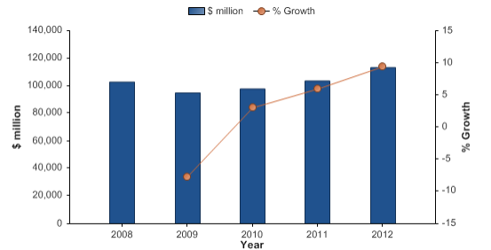
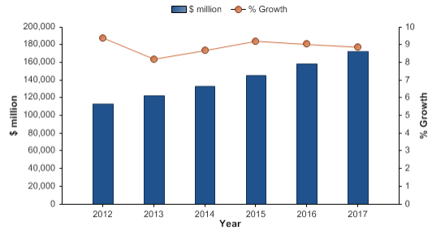
Global Professional Services Industry: Market Overview US Management & Marketing Services
Market Value
The US management & marketing consultancy market had total revenues of $113.3bn in 2012, representing a compound annual growth rate (CAGR) of 2.5% between 2008 and 2012. In comparison, the European and Asia-Pacific markets grew with CAGRs of 2.7% and 0.7% respectively, over the same period, to reach respective values of $113.3bn and $35.4bn in 2012.
Year | $ Million | % Growth
2008 | 102793.0
2009 | 94896.0 | (7.7%)
2010 | 97757.0 | 3.0%
2011 | 103565.0 | 5.9%
2012 | 113300.1 | 9.4%
CAGR |  | 2.5%
Market Value Forecast
The performance of the market is forecast to accelerate, with an anticipated CAGR of 8.8% for the five-year period 2012 - 2017, which is expected to drive the market to a value of $172.7bn by the end of 2017. Comparatively, the European and Asia-Pacific markets will grow with CAGRs of 5.7% and 2.7% respectively, over the same period, to reach respective values of $149.2bn and $40.4bn in 2017.
Year | $ Million | Growth(%)
2012 | 113300.1 | 9.4%
2013 | 122590.7 | 8.2%
2014 | 133241.5 | 8.7%
2015 | 145518.0 | 9.2%
2016 | 158662.0 | 9.0%
2017 | 172742.6 | 8.9%
CAGR 2012-17 |  | 8.8%
Notes:
Aug 2013 Marketline

Slide 17
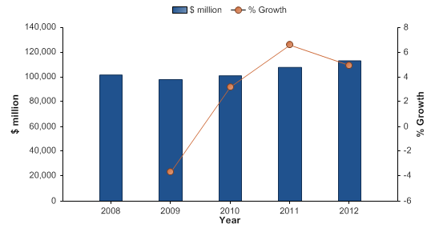
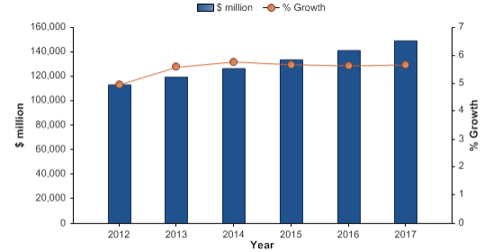
Global Professional Services Industry: Market Overview Europe Management & Marketing Services
Market Value
The European management & marketing consultancy market had total revenues of $113.3bn in 2012, representing a compound annual growth rate (CAGR) of 2.7% between 2008 and 2012. In comparison, the German and UK markets grew with CAGRs of 4.9% and 1.6% respectively, over the same period, to reach respective values of $41.3bn and $23.1bn in 2012.
Year | $ Million | % Growth
2008 | 101823.1
2009 | 98093.8 | (3.7%)
2010 | 101239.4 | 3.2%
2011 | 107915.7 | 6.6%
2012 | 113263.3 | 5.0%
CAGR |  | 2.7%
Country | $ Million(2012) | % Share
UK | 23126.5 | 36.4%
France | 10832.3 | 20.4%
Germany | 41255.6 | 11.3%
Italy | 3875.1 | 9.6%
Spain | 12810.8 | 3.4%
Rest | 21363.0 | 18.9%
Market Value Forecast
The performance of the market is forecast to accelerate, with an anticipated CAGR of 5.7% for the five-year period 2012 - 2017, which is expected to drive the market to a value of $149.2bn by the end of 2017. Comparatively, the German and UK markets will grow with CAGRs of 8% and 5.2% respectively, over the same period, to reach respective values of $60.7bn and $29.8bn in 2017.
Year | $ Million | Growth(%)
2012 | 113263.3 | 5.0%
2013 | 119587.1 | 5.6%
2014 | 126490.1 | 5.8%
2015 | 133668.1 | 5.7%
2016 | 141198.5 | 5.6%
2017 | 149197.1 | 5.7%
CAGR 2012-17 |  | 5.7%

Slide 18
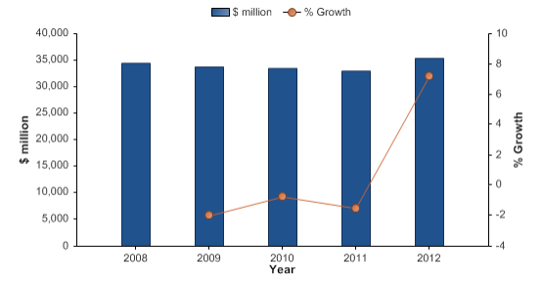
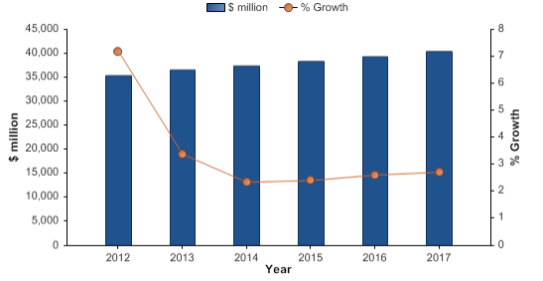
Global Professional Services Industry: Market Overview Asia Pacific Management & Marketing Services
Market Value
The Asia-Pacific management & marketing consultancy market had total revenues of $35.4bn in 2012, representing a compound annual growth rate (CAGR) of 0.7% between 2008 and 2012. In comparison, the Chinese market increased with a CAGR of 1.4%, and the South Korean market declined with a compound annual rate of change (CARC) of -2.2%, over the same period, to reach respective values of $2.8bn and $1.5bn in 2012.
Year | $ Million | % Growth
2008 | 34435.5
2009 | 33749.4 | (2.0%)
2010 | 33495.0 | (0.8%)
2011 | 32990.0 | (1.5%)
2012 | 35361.4 | 7.2%
CAGR |  | .7%
Country | $ Million(2012) | % Share
India | 2015.2 | 5.7%
South Korea | 1522.3 | 4.3%
Japan | 25094.4 | 71.0%
China | 2780.9 | 7.9%
Rest | 3948.6 | 11.2%
Market Value Forecast
The performance of the market is forecast to accelerate, with an anticipated CAGR of 2.7% for the five-year period 2012 - 2017, which is expected to drive the market to a value of $40.4bn by the end of 2017. Comparatively, the Chinese and South Korean markets will grow with compound annual growth rates (CAGRs) of 7.3% and 0.1% respectively, over the same period, to reach respective values of $3.9bn and $1.5bn in 2017.
Year | $ Million | Growth(%)
2012 | 35361.4 | 7.2%
2013 | 36557.2 | 3.4%
2014 | 37416.5 | 2.4%
2015 | 38319.4 | 2.4%
2016 | 39321.7 | 2.6%
2017 | 40391.1 | 2.7%
CAGR 2012-17 |  | 2.7%

Slide 19
Global Professional Services Industry: Market Overview
HR & Employment Services
The human resources and employment services market consists of revenues received for provision of temporary staffing, search and placement (permanent staffing), and corporate training services provided by external service providers. Other employment services, such as independent contracting and employee leasing are not considered in this report.
Market Value
Year | $ billion | % Growth
2008 | 394.1
2009 | 317.3 | (19.5)
2010 | 343.4 | 8.2
2011 | 378.2 | 10.1
2012 | 389.2 | 2.9
CAGR
Market Volume
Year | Thousand temporary stuff as FTE | % Growth
2008 | 17574.1
2009 | 16116.5 | (8.3)
2010 | 18447.5 | 14.5
2011 | 20798.2 | 12.7
2012 | 22524.2 | 8.3
CAGR |  | 6.4
Notes:
Marketline-2013

Slide 20
Global Professional Services Industry: Market Overview
HR & Employment Services
Geographic Segmentation
Geography | $ billion (2012) | Market Share(%)
Americas | 144.9 | 37.2
Europe | 145.7 | 37.4
Asia-Pacific | 82.8 | 21.3
Middle East & Africa | 15.8 | 4.1
Total | 389.2
Market Value Forecast
Year | $ billion | Growth(%)
2012 | 389.2 | 2.9
2013 | 412.2 | 5.9
2014 | 432.3 | 4.9
2015 | 454.6 | 5.2
2016 | 478.9 | 5.3
2017 | 504.1 | 5.3
CAGR 2012-17 |  | 5.3

Slide 21
Global Professional Services Industry: Market Overview
HR & Employment Services
Forecasted Market Volume
Year | Thousand temporary stuff as FTE | % Growth
2012 | 22524.2 | 8.3
2013 | 24481.5 | 8.7
2014 | 26716.8 | 9.1
2015 | 29226.1 | 9.4
2016 | 31990.1 | 9.5
2017 | 34946.1 | 9.2
CAGR |  | 9.2
Top Players
Company | Revenue(2012) | Net Income
Adecco SA | 28569.8m$ | 524.5
Manpower Group Inc | 20678m$ | 197.6
Randstad Holding | 23771.3m$ | 51.1
Allegis Group Inc | NA | NA

Slide 22
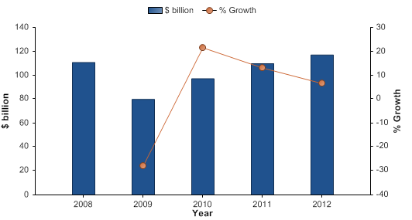
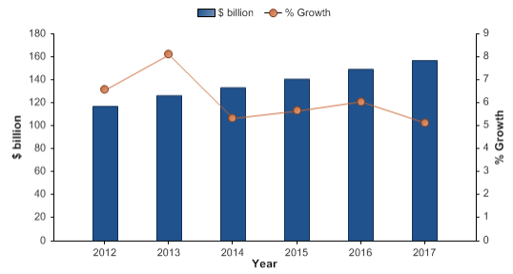
Global Professional Services Industry: Market Overview
US HR & Employment Services
Market Value
The US employment services market had total revenues of $117.0bn in 2012, representing a compound annual growth rate (CAGR) of 1.4% between 2008 and 2012.
Year | $ billion | % Growth
2008 | 110.8
2009 | 79.9 | (27.9%)
2010 | 97.1 | 21.5%
2011 | 109.8 | 13.1%
2012 | 117.0 | 6.6%
CAGR
Market Value Forecast
The performance of the market is forecast to accelerate, with an anticipated CAGR of 6% for the five-year period 2012 -2017, which is expected to drive the market to a value of $156.9bn by the end of 2017.
Year | $ billion | Growth(%)
2012 | 117.0 | 6.6%
2013 | 126.5 | 8.1%
2014 | 133.2 | 5.3%
2015 | 140.7 | 5.6%
2016 | 149.2 | 6.1%
2017 | 156.9 | 5.1%
CAGR 2012-17
Notes:
Sep 13

Slide 23
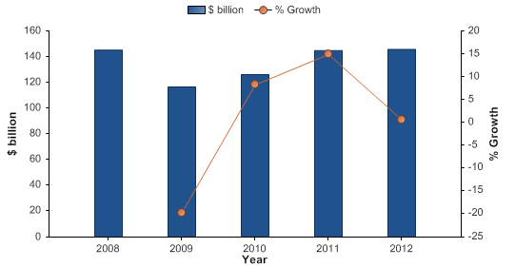
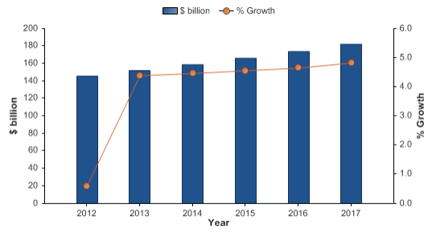
Global Professional Services Industry: Market Overview
Europe HR & Employment Services
Market Value
The European employment services market had total revenues of $145.7bn in 2012, representing a compound annual growth rate (CAGR) of 0.1% between 2008 and 2012. In comparison, the German market increased with a CAGR of 2.8%, and the UK market declined with a compound annual rate of change (CARC) of -1.4%, over the same period, to reach respective values of $21.1bn and $40.4bn in 2012.
Year | $ billion | % Growth
2008 | 145.2
2009 | 116.5 | (19.7%)
2010 | 126.1 | 8.2%
2011 | 144.8 | 14.9%
2012 | 145.7 | .6%
CAGR |  | .1%
Country | $ Million(2012) | % Share
UK | 40.4 | 27.7%
France | 25.2 | 17.3%
Germany | 21.1 | 14.5%
Italy | 9.7 | 6.7%
Spain | 3.0 | 2.0%
Rest | 46.3 | 31.8%
Market Value Forecast
The performance of the market is forecast to accelerate, with an anticipated CAGR of 4.6% for the five-year period 2012 - 2017, which is expected to drive the market to a value of $182.2bn by the end of 2017. Comparatively, the German and UK markets will grow with compound annual growth rates (CAGRs) of 8.7% and 4.9% respectively, over the same period, to reach respective values of $31.9bn and $51.4bn in 2017.
Year | $ billion | Growth(%)
2012 | 145.7 | .6%
2013 | 152.1 | 4.4%
2014 | 158.9 | 4.5%
2015 | 166.1 | 4.6%
2016 | 173.9 | 4.6%
2017 | 182.2 | 4.8%
CAGR 2012-17 |  | 4.6%

Slide 24
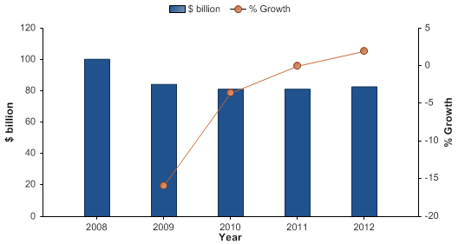
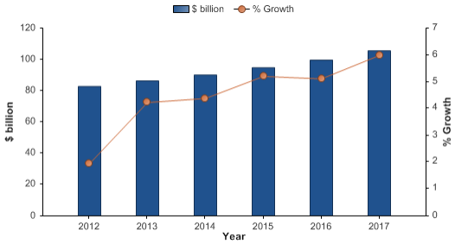
Global Professional Services Industry: Market Overview
Asia Pacific HR & Employment Services
Market Value
The Asia-Pacific employment services market had total revenues of $82.8bn in 2012, representing a compound annual rate of change (CARC) of -4.7% between 2008 and 2012. In comparison, the Chinese and South Korean markets grew with compound annual growth rates (CAGRs) of 16.1% and 5.2% respectively, over the same period, to reach respective values of $6.1bn and $2.1bn in 2012.
Year | $ billion | % Growth
2008 | 100.2
2009 | 84.3 | (15.9%)
2010 | 81.2 | (3.6%)
2011 | 81.2 | 0.0%
2012 | 82.8 | 1.9%
CAGR |  | (4.7%)
Country | $ Billion(2012) | % Share
India | 1.2 | 1.5%
South Korea | 2.1 | 2.5%
Japan | 48.1 | 58%
China | 6.1 | 7.3%
Rest | 25.3 | 30.6%
Market Value Forecast
The performance of the market is forecast to accelerate, with an anticipated CAGR of 5% for the five-year period 2012 -2017, which is expected to drive the market to a value of $105.6bn by the end of 2017. Comparatively, the Chinese and South Korean markets will grow with CAGRs of 13% and 6% respectively, over the same period, to reach respective values of $11.2bn and $2.8bn in 2017.
Year | $ billion | Growth(%)
2012 | 82.8 | 1.9%
2013 | 86.3 | 4.2%
2014 | 90.1 | 4.4%
2015 | 94.8 | 5.2%
2016 | 99.6 | 5.1%
2017 | 105.6 | 6.0%
CAGR 2012-17 |  | 5.0%

Slide 25
Global Professional Services Industry: Market Overview Real Estate Management & Development Market
Market Value
The real estate management and development industry consists of companies engaged in real estate ownership, management and/or development.
The industry is valued using the total revenues generated by these companies via leasing and property management activities
Global real estate management and development market value: $ billion, 2006–10
The market had total revenues of $479.3 billion in 2011, representing a CAGR of -0.5% between 2007 and 2011
The market is forecasted to decelerate, with an anticipated CAGR of -0.1% for 2011 - 2016, which is expected to drive the market to a value of $477 billion by the end of 2016
Global real estate management and development market value: $ billion, 2007–11
$ billion
% growth
Year | $ billion | % Growth
2007 | 488.5
2008 | 501.6 | 2.7%
2009 | 461.4 | -8.0%
2010 | 460.4 | -0.2%
2011 | 479.3 | 4.1%
CAGR: 2007–11 |  | -0.5%
Year
Notes:
Market Line Industry Profile - Global Real Estate Management & Development (May 2012)

Slide 26
Global Professional Services Industry: Market Overview Real Estate Management & Development Market
Market Segment
Global real estate management and development market segmentation by service category:% share, by value, 2010
Category | 2011 ($ billion ) | %
Residential | 272.24 | 56.8%
Non-Residential | 207.06 | 43.2%
Global real estate management and development market segmentation by geography:% share, by value, 2010
Category | 2011 ($ billion ) | %
Americas | 193.6 | 40.4%
Europe | 161.0 | 33.6%
Asia- Pacific | 110.2 | 23.0%
Middle East & Africa | 13.9 | 2.9%
Notes:
Market Line Industry Profile - Global Real Estate Management & Development (May 2012)

Slide 27
Table of Content
Global Professional Services MI
Industry Insights
Disclaimer:
The information presented in this report is based on data available in the public domain. If you find that it is incorrect, please let us know.

Slide 28
Global Professional Services MI: Industry Insights Porter's 5 forces Analysis- Accountancy Services
Rivalry- Strong
• Despite the dominant position of the "big four" firms, the global accountancy market is fairly fragmented overall, which increases rivalry- players are very similar to each other
• Although accountancy firms have few specialized physical assets to dispose of, their staff will tend to have specialized skills.
• Exiting the accountancy market would therefore incur costs: IT systems could be re-deployed in another business area, but laying off a large staff and recruiting a new one with different skills is not a trivial exercise
Supplier Power- Moderate
• Suppliers in the accountancy market consist of specialized accountancy software publishers
• Large accountancy firms need more specialized technology, and therefore rely on a limited range of suppliers to provide this
• the wide range of low end and high end products on offer, such as ERP software- weakens supplier power
• Other suppliers to accountancy firms will include manufacturers of PCs and office equipment.
•Accountancy firms require a reliable ICT infrastructure to be in place and therefore often commit to one supplier's product
New Entrants- Strong
• Entry to the global accountancy market may be achieved by an individual accountant establishing a single practice. For such a low-key entry, there is relatively little capital outlay or proprietary knowledge involved
• The global market has grown at a healthy rate in recent years, making it attractive to new entrants
• The leading companies have strong brand reputations
• Competing for the largest clients is difficult except for the major accountancy firms
• Replication of competencies can be costly, and constitutes a barrier to market entry
Buyer Power- Moderate
• Buyers can vary in size but include many medium and large businesses, which strengthens buyer power considerably
• Four major players dominate the accountancy market: PWC, KPMG, Deloitte Touché Tohmatsu, and Ernst & Young- limited choice of player for the largest corporate clients
• Switching from a "big four" auditor to a smaller player may be viewed negatively by the capital markets
• Buyer power is strengthened by the fact that accountants as such can rarely integrate forwards into their clients' businesses, while clients can carry out some accounting functions in-house
Threat of Substitutes - Weak
• While there are no obvious substitutes for the functions offered by accountants, specialized accountancy firms do face the threat of substitutes
• For private individuals, "DIY" accounting is often a possibility
• This substitute avoids costs in terms of fees paid to a third-party accountant, but may incur other costs, such as the time absorbed by the process, and the greater possibility of mistakes being made
There may also be switching costs, such as the need to purchase appropriate software
• Also, the important function of auditing cannot by its nature be performed in-house
- 28 -
Notes:
Sources:

Slide 29
Global Professional Services MI: Industry Insights Porter's 5 forces Analysis- Legal Services
Rivalry- Strong
• Legal firms can diversify their practice in terms of the range of areas they are involved in, from antitrust and competition to banking and finance, which tends to ease rivalry
• For the biggest firms that cover the breadth of the market, there is huge rivalry for reputation and the big deals
• Since liberalization, basic legal tasks can be completed at reduced costs in many countries
Supplier Power- Moderate
• Suppliers in this market include manufacturers of ICT equipment and office supplies
• As market players often stick to one ICT supplier in order to keep consistency throughout the business and avoid the difficulties of training staff on new computer systems, supplier power is increased
• The biggest cost, and subsequently asset, for a law firm is its staff, which needs to be of a high quality to maintain a competitive edge over rivals
•The success of the practice as a whole depends on attracting and retaining suitably qualified legal professionals, with expertise in the specific areas of law in which the partnership operate- Should one partner leave, it may be difficult to find a replacement with equivalent skills
New Entrants- Strong
• The global legal services market is continuing to expand, providing ample opportunities for new players wanting to enter
• Leading incumbents have some advantages, which may make it harder for new entrants to compete
• A larger firm may have economies of scale, being able to offer a broader range of expertise to clients
• It may be difficult for clients to assess the relative skills of competing firms in this market, and a high reputation ('brand strength') is an advantage for certain incumbents that new entrants cannot immediately offer
• There may be restrictions on foreign lawyers practicing within a particular country, although WTO rules generally favor greater international trade in services, including legal services
Buyer Power- Moderate
• Wide variety of potential customers in the market- weakens buyer power
• Larger clients tend to have stronger bargaining power
• Switching tends to be fairly low-cost in this market
• The services offered by legal practitioners are generally highly important to buyers. However, larger companies may backwards integrate by introducing in-house legal services, thus putting legal firms under pressure
• Brand can play an important role in the legal services market, with reputation often being an important factor when choosing a legal services company
• Services offered by law firms tend to be very similar, however companies may differentiate themselves by specializing in one area
Threat of Substitutes - Moderate
• While there are no obvious substitutes to legal services as such, some individuals may choose to represent themselves
• However, legal issues can be complex, the consequences of errors can be significant, and for businesses undertaking a wide range of activities, including mergers and acquisitions, professional legal expertise is a must
• However, the biggest threat to third-party legal firms is the use of in-house lawyers
• Large companies may operate in-house departments that handle the majority of the corporation's legal needs. The advantages of this for buyers may include reduced costs if the service is commonly required, and a more tailored service as the lawyers are focused on only one company
- 29 -
Notes:
Sources:

Slide 30
Global Professional Services MI: Industry Insights Porter's 5 forces Analysis- HR & Employment Services
Rivalry- Strong
• The global market consists of a large number of highly reputable companies with strong brand names, which boosts the competition level
• The growth of internet services has reduced barriers to entry and has triggered a growth in the number of players in this market
•The larger players present similar business models and usually conduct diversified operations
• Demand for services is dependent upon a number of global trends, such as demand for skilled workers, as well as economic growth
Supplier Power- Moderate
• Market players invest large sums of money in ICT systems, for which they typically have contracts with large technology providers and therefore incur raised switching costs
• likely to remain with one ICT supplier in order to maintain consistency throughout the business
• Changing suppliers can incur significant costs in terms of staff training, or the impact of a new system not being compatible with an existing one
• With high unemployment rates as a result of the global economic downturn, the abundance of prospective employees weakens supplier power
New Entrants- Moderate
• Large companies in this market benefit from significant scale economies in terms of marketing and back-office operations
• small companies can compete successfully by specializing
• However, some country markets are becoming more heavily regulated in terms of improvements in legislation to protect temporary workers from exploitative employment practices
• Strong market growth may attract new entrants. Uncertainty in the global economy tends to direct buyers towards staff reductions in order to lower their costs; thus new entrants may be discouraged from entering the market
Buyer Power- Strong
• Wide variety of potential customers in the market with large and medium sized businesses, with financial muscle allowing them to make large purchases
• Number of buyers is limited by difficult global economic conditions and the automation of business processes due to advances in ICT
• Switching costs are not significant
• More buyers are moving towards consolidating their purchases by using a single market player or a small group of them
• Many buyers backward integrate, conducting their own human resources and employment services thereby reducing their dependence on market players
Threat of Substitutes - Strong
• Buyers conducting their own recruitment and human resources, rather than out-sourcing to market players
• The use of market players can be beneficial; for example, in terms of sourcing the most suitable employees and saving time
• Another form of substitution exists in terms of web-based operations; however, most of the players have already incorporated this method of operating into their business models
- 30 -
Notes:
Sources:

Slide 31
Global Professional Services MI: Industry Insights Porter's 5 forces Analysis- Management & Marketing Consultancy
Rivalry- Moderate
• The leading firms in this market are typically large corporations, intensifying the rivalry as they can harness greater power for competitive practices
• High service differentiation and low exit barriers ameliorate the rivalry as firms compete in different areas and will not stay and compete due to the sunk costs involved if exit was necessary
•The persisting global slowdown has forced many firms which would use consulting services to consolidate and delay new investment projects
• The steady growth in the market means expanding revenue streams will mollify the rivalry
Supplier Power- Strong
• Suppliers- producers of ICT hardware and software, typically large multinational firms
• Firms are also beginning to capitalize on social media, with project managers attempting to integrate it into ERP systems
• Emerging services involve binding companies with long term contracts, which would incur high switching costs, not only to exit the contract, but also to conduct the restructuring of the systems and subsequent training necessary
• Although some providers have their own consultancy division, such as IBM’s Global Services, forward integration by suppliers is unlikely
New Entrants- Moderate
• The leading firms are multinational companies with strong brand images
• Smaller firms with specialist services successfully compete in the market
• The large companies benefit from economies of scale, combined with a vast knowledge pool spanning many industries and sectors
• Track record of improving cost-efficiency is a distinct advantage, which presents a significant barrier for new, unproven companies
• Firm involves a high degree of specialist and proprietary knowledge, with established companies developing a high degree of in house expertise, disadvantaging new entrants
• Moderate growth observed by the market in recent years will act as an incentive for new companies to enter
Buyer Power- Strong
• The public sector is a big customer for the services in order to improve efficiency and reduce long term costs
• This demand looks uncertain in the short term as many governments implement austerity programs
• The service is relatively costly due to the high level of specialized knowledge required and can act as a deterrent for smaller companies
• Consulting is quite a dispensable product for firms' operations, but will still prove necessary in some cases, such as when the existing management structure proves inadequate to accommodate a large change process
• The market permits large differentiation and customization of the services offered, which dilutes buyer power
Threat of Substitutes - Strong
• Many larger companies and organizations have created in-house business departments which employ analysts and marketing teams for business insights and to achieve organizational efficiencies
• However, running such a department can be very costly and only well established companies with the constant need for these services may possess the resources to do so.
• Only mature consultancy firms could be a match for in-house departments when it comes to the knowledge of a specific area of a market that an individual company's operations will have accumulated over many years
- 31 -
Notes:
Sources:

Slide 32
Global Professional Services MI: Industry Insights Porter's 5 forces Analysis- Real Estate Management & Development
Rivalry- Moderate
• The industry is highly fragmented with small companies competing alongside large multinational players
• Typical player generates little revenue in other markets, meaning that the real estate industry is highly important to revenues
•Globally, growth rates in recent years have been unexciting; and a decline in value has been seen in recent years
• Player who are able to diversify geographically may find some regions more profitable than others
• The recent economic downturn has led to increased tenant bankruptcies, which in turn have led to an increase in vacancy rates and losses in companies' revenues
Supplier Power- Moderate
• Suppliers- building and construction contractors
• The large number of such companies serves to weaken supplier power considerably
• Supplier offerings are mostly undifferentiated service.
• Certain contracts are long term which associates switching cost
• The services offered by suppliers are of importance to market players, strengthening supplier power further
• The ability of market players to attract and retain employees is generally vital to the success of a business
New Entrants- Moderate
• Financial pressure can arise for new companies, as significant investment is required and there is usually a period of time before revenues
• Global economic crisis has led to more stringent credit market requirements and regulations, making the raising of necessary capital more difficult
• The markets in which players operate can often be uncertain
• Such uncertainty can be off-putting for potential new entrants
• Forecast market stagnation over the coming years will do little to entice new entrants to the market
Buyer Power- Moderate
• Buyers within this industry are of widely disparate size and financial strength, so the effect of their large number, usually weakening buyer power, may be mitigated by their strong financial muscle and ability to negotiate with players
• Name recognition can play a role in attracting buyers in this industry
• However price, location, suitability, and related factors, are likely to be more important
• Market players can differentiate themselves through the types of property they offer, location and services offered, such as brokerage
Threat of Substitutes - Weak
• From the point of view of customers, the main alternative to real estate management is to buy property, rather than lease it
• Property may be bought using a variable-interest loan: both interest rates and rents can be unpredictable in the medium- to long term
• Property owners will have responsibilities for maintenance etc, which management and development companies would often include as part of their service
- 32 -
Notes:
Sources:

Slide 33
Table of Content
Global Professional Services MI
Deals Space
Disclaimer:
The information presented in this report is based on data available in the public domain. If you find that it is incorrect, please let us know.

Slide 34
Global Professional Services Industry: Deals Space
Existing Contract List for HR & Employment Services
Existing Contract List for Legal Services
Existing Contract List for Management & Marketing Consultancy
Existing Contract List for Real Estate
Existing Contract List for Accountancy Services
- 34 -
Notes:
Source:
IDC Contracts Database

Slide 35
Table of Content
Global Professional Services MI
Business Trends
Disclaimer:
The information presented in this report is based on data available in the public domain. If you find that it is incorrect, please let us know.

Slide 36
Global Professional Services Industry: Business Trends Key Market Trends in Accountancy Services
Changing Skills & Changing Job titles
Rather than just collecting data and presenting it to management, accountants are being called on to analyze the numbers and the business environment and then to tell management about how companies are truly performing, how they can be expected to perform moving forward, and what steps management might take to improve future performance. This new emphasis on strategic input in accounting means that it will be more important than ever for accountants to have a deep working knowledge of technology, leadership ability, an understanding of the broad business environment, and the ability to communicate with colleagues in a diversity of corporate departments and functions.
Forensic Accounting
Forensic accounting is not new. But tighter scrutiny of business practices that followed high-profile financial scandals have put the specialty on the map.
Forensic accountants are helping clients set up fraud prevention programs, provide litigation support, and delve behind the numbers to detect sophisticated crimes including embezzlement, securities fraud, bribery and money laundering. The Bureau of Labor Statistics predicts that as the success rate of investigations conducted by forensic accountants continues to grow, so will the demand for their services.
Estate Planning / Elder Care: Focus
The aging population is generating a growing need for competent guidance in retirement planning, estate planning and wealth preservation. Many accounting firms are also setting up elder care departments devoted to helping older clients and their families with issues such as long-term care, Medicare, Medicaid and financial strategies for staying in a personal residence.
Sarbanes-Oxley (SOX)
The Sarbanes-Oxley Act was passed in response to a flood of corporate accounting scandals. But it contains a morass of other requirements of companies-meaning a more complex and expensive job for the public accounting firms auditing companies' books. In response, some smaller accounting firms have stopped auditing publicly traded clients, citing increased costs associated with such engagements. The Big Four, meanwhile, are licking their chops. More complexity in corporate accounting regulations means more complex audit engagements, after all-complete with higher fees. Indeed, according to a survey conducted by Financial Executives International, companies needing audits in the wake of Sarbanes-Oxley expect to pay more than a third more than they used to for audit engagements.
Big 4 & Upsurge in New Accounting Firms
Accounting Industry is dominated by Big Four: Deloitte Touche Tohmatsu, Ernst & Young, KPMG, and PricewaterhouseCoopers. Big Four clients are Fortune 1000 companies, which means that employees are exposed to complex accounting issues.
Although the Big Four get most of the publicity, there are many smaller, less well-known national players and regional public accounting firms that hire lots of people. Representative national firms include Grant Thornton, McGladrey & Pullen, BDO Seidman, and Moss Adams.
- 36 -
Notes:
Sources:
http://www.hingemarketing.com/blog/story/5_trends_shaping_the_future_of_accounting_marketing/
http://www.ehtc.com/resources/news-articles/bid/88667/Five-Trends-Shaping-the-Accounting-Industry
http://www.accountingdepartment.com/blog/improving-sales/accounting-services-industry-trends-virtual-accounting-personalized-service/
http://www.wetfeet.com/articles/industry-overview-accounting

Slide 37
Global Professional Services Industry: Business Trends Key Market Trends in Legal Services
e-discovery: Recent amendments to Federal Rules make electronically stored information like e-mails, instant messages, voicemails, e-calendars, graphics and data on handheld devices discoverable in litigation. The discovery of electronically stored information (ESI) is known as electronic discovery. New roles in litigation support, e-discovery and trial technology have emerged to address the electronic realities of a digital age.
Multigenerational Workforce: As attorneys, paralegals and other legal professionals work beyond retirement age, many law firms and legal departments are trying to balance a generation gap of more than 50 years between the oldest and youngest employees.
Social Networking: Social networking is changing how legal professionals recruit, job hunt, network, locate and discredit witnesses, manage their careers and interact with clients.
Eco-Consciousness: In response to global warming, economic pressure and eco-conscious clients, law firms and legal professionals are establishing green initiatives to cut expenses, reduce carbon footprint & promote social responsibility. Environmental law or "green law" is a growing practice area and many firms are establishing niche sub-practices in fair trade, organics, renewable energy, green building and climate change.
Virtual Law Firms: Powerful mobile devices, software-as-a service and secure, web-based technology allow legal professionals to work from virtually anywhere.
Demand for legal services has been softening as the supply of lawyers has been expanding. Only in recent years have law schools seen their enrollments flatten after decades of steady increases and continually rising bids for graduating “stars.” Meanwhile, clients have become increasingly savvy about bringing legal work in-house, hiring contract lawyers, bargaining for discounts and fixed fees, and even outsourcing some legal tasks (such as discovery tasks) to technology providers or other non-lawyer specialists,
Legal service outsourcing continues to grow at an accelerating pace. Providers of digital discovery solutions, intellectual property research firms and consultants, compliance consultants focused on one type of regulation, and corporate service providers who perform incorporations and a growing number of other routine corporate tasks are just some of the outsource providers that are competing with law firms in recent years. In many fields, such as the electronic discovery field, they still hold a minority percentage of the overall market share for services in their discipline, but that share is growing quickly, as Duncan notes, at compound annual growth rates well above 50 percent in many fields.
Technology is proving to be not only a tool, but a disruptive market force for lawyers. Predictive coding and artificial intelligence that allows computers to “learn” as they do tasks will pave the way for computers to sift through mounds of documents to find key data faster, more effectively and more cheaply than lawyers. Computers, aided by lawyers (either at firms or more likely at outsource specialists) will be used more and more often by clients. As Watson-like artificial intelligence is applied to all kinds of databases (such as databases full of every case, regulation, and statute) even legal research will become a task for technology, minimally guided by lawyers.
- 37 -
Notes:
Sources:
http://johnocunningham.wordpress.com/2013/07/28/market-trends-that-law-firms-cant-ignore/

Slide 38
Global Professional Services Industry: Business Trends Key Market Trends in Legal Services
Critical Shift in market of Legal Services
There has been a shift from the seller's market that traditionally dominated the legal industry to a buyer's market that will likely remain the prevailing model for the foreseeable future. All of the critical decisions related to the structure and delivery of legal services – including judgments about scheduling, staffing, scope of work, level of effort, pricing, etc. – are now being made primarily by clients and not by their outside lawyers. This represents a fundamental shift in the relationship between lawyers and their clients.
The second critical shift in the legal market in the last four years has been the dramatic increase in competition among firms. Given current economic trends, it appears likely that the legal market will remain in this state of heightened competition for at least a few more years.
Pressure on Traditional Partnership Model
As firms have struggled with sluggish demand growth and low productivity, they have increasingly raised the bar for admission to their equity partnerships and increased the number of lawyers in non-equity partnership positions, sometimes through "de-equitizations.“Among AmLaw 200 firms, 169 reported having two-tiered partnerships 19 in 2011, an increase over the 166 reported in 2005and the 146 reported in 2000. Similarly, the percentage of AmLaw 200 lawyers who are equity partners dropped to 25 percent in 2011, down from 34 percent in 2005 and 36 percent in 2000. 20 Further, an analysis of the AmLaw 200 survey data from 2006 through 2012 shows a compound annual growth rate ("CAGR") of 1.2 percent for equity partners and 7 percent for non-equity partners. Increasingly, a lawyer's ability to generate significant business (often called client originations) has emerged as the critical dividing line between equity and non-equity partners.
Growing Market Segmentation
There has been a noticeable segmentation among law firms themselves, as some firms have staked out market positions as providers of high end financial services or general corporate services on a global basis, there has been a noticeable segmentation among law firms themselves, as some firms have staked out market positions as providers of high end financial services or general corporate services on a global basis.
This segmentation among firms has been bolstered by an increasing willingness on the part of clients to "disaggregate" matters – both litigation and transactional – by parceling out t different parts or phases of matters to different firms depending on expertise & pricing.
Changing Business Models
It is undeniable, however, that the governance and management structures of law firms have changed significantly over the past 20 years and that the market shifts of the past four years are likely to continue that trend. It is also true, as previously noted, that these changes – coupled with the adverse financial impact of the economic downturn – have resulted in increased stress levels and growing morale problems in many firms, as large numbers of partners have felt themselves increasingly disenfranchised. It have opined that the legal market (at least as regards large law firms) is moving inexorably toward a corporate model of essentially top-down management, in which practicing lawyers will become little more than fungible employees.
Growing Pace of Globalization
Despite (or perhaps partly because of) the challenging economics of the current legal market, 2012 was a banner year for global expansion of U.S. and international law firms. In addition, U.S. law firms in 2012 continued a very aggressive global expansion through the opening of new offices around the world. This aggressive global expansion obviously reflects strategic judgments on the part of many firms that a more credible and comprehensive global footprint is needed to serve the needs of their international clients
- 38 -
Notes:
http://www.law.georgetown.edu/continuing-legal-education/executive-education/upload/2013-report.pdf

Slide 39
Global Professional Services Industry: Business Trends Key Market Trends in HR & Employment Services
Unemployment will remain high by historical standards- To find the workers who can serve employers’ needs, staffing firms will need to refine their ability to hone in on specific skills. This could involve deepening their networking connections with workers who have specialized expertise, for example. For the softer skills that Wolfe mentioned, staffing firms will need to be able to gauge how important they are for a particular position, and how well candidates would do
Demand for knowledge workers will increase- If firms see their customers becoming less tied to local labor, for example, they may need to find ways to provide workers in other locations. This broadening of the location of work could also open up new opportunities for staffing firms to provide workers outside their immediate areas
Generations will mix increasingly at work- Staffing firms, like the companies that are their customers, will be working with a broader generational mix than in the past. They will have to find ways to recruit and motivate workers from both ends of the generational spectrum – as well as those in between.
Workers will continue to move away from long-term employment with one company- The continuing move away from the traditional model of spending decades with one employer will likely open up new opportunities for staffing companies. Although the idea of contract employment is appealing to many workers, health insurance, retirement plans and a steady paycheck also remain important draws.
Just as growth in certain sectors will continue into the new year, so too will various trends in employee management and recruiting. HR’s use of cloud computing (essentially, online networking services) is expected to increase because of the security and convenience they offer both employers and job seekers, who can now conduct interviews via websites like Skype or undertake training using other internet-based tools.
Likewise, the importance of social media will continue its rise in the world of HR, with more and more employers relying on social media sites, such as LinkedIn, Facebook, and Twitter, to attract new talent, provide customer feedback, and monitor company performance. Other expected trends in HR for 2013 include: increased use of temporary workers, HR outsourcing, and increased challenges in retaining employees due to intense hiring competition.
- 39 -
Notes:
Sources:
http://www.staffingtalk.com/staffing-industry-trends-2012-expert-predictions/

Slide 40
Global Professional Services Industry: Business Trends Key Market Trends in Employment Services
Global Trends affecting the talent strategy
Most companies are being affected by one or more trends. It is absolutely critical for leaders to connect economic challenges and emerging business imperatives to the workforce profile required for future success. Businesses are being affected or disrupted by global economic and technological trends. As we have seen, employee demographics will have a big impact both in terms of where available talent will be around the globe, and also in terms of how large segments like Millennials and Baby Boomers are changing the expectations workers have of their companies
Focus on the engagement behaviors required for performance and business success.
Getting real about employee engagement requires moving beyond a generic concept and clarifying the behaviors in which company would like employees to go above and beyond. For many employers there is increasing need for agility, speed and flexibility—these traits and behaviors will vary by industry and job profile. Clarifying what engagement looks like for employees is a prerequisite to their engagement. Aligning performance management, people management, learning and development, and rewards and recognition with these engaged behavior expectations will focus, enable and reinforce employees’ efforts and energy.
Culture of engagement
Companies need to take a holistic view beyond the employee engagement outcome alone. Healthy organizations with strong cultures demonstrate concerted effort, and top quartile performance in not just employee engagement but also brand, performance orientation and leadership.
Focus: Build engaging leaders to keep employees motivated
Engaging leaders—or leaders who are very engaging of others—have been shaped by early experiences, have beliefs about purpose and people, and behave in ways that inspire, focus, stabilize, build trust, and connect with and grow others. Leaders can be assessed, selected and developed based on this profile. Those companies that focus on building engaging leaders will see an exponential impact on employee engagement.
Deliver on a compelling employee value proposition (EVP)
Employees want to be valued and provide value in return. Many trends have created a disconnect between what companies require, what they are offering and what employees expect in return in order to unlock their full engagement. Top engagement drivers such as career
opportunities, pay for performance and communication provide some insight into how employees define value from their company. Employees are also engaged by a company with a strong reputation. Companies that have a compelling and aligned EVP will have employees who say positive things about their organization, will want to stay and will strive to go above and beyond in their jobs.
- 40 -
Notes:
http://www.aon.com/attachments/human-capital-consulting/2014-trends-in-global-employee-engagement-report.pdf

Slide 41
Global Professional Services Industry: Business Trends Key Market Trends in Management Consultancy
Low levels of growth in Europe: The European consulting industry may bounce back, but much rests on the continued strength of the German market which grew by just over 7 per cent in 2011, and was the second biggest in the region (behind the UK). On balance, a lot relies on the performance of the financial services industry across all European countries. Things could head in either direction, but Source expects more of the same – low levels of growth across the European consulting industry.
Testing strategies: Source client research has identified three major opportunities for growth for consulting firms in 2013: new services, new roles, and new delivery models. Of those, new delivery models – which concerns consulting firms moving away from the old pyramid consulting model in favor of something more flexible – appears to hold the greatest potential. In response, says Source, consulting firms appear to have identified 10 different strategies: in 2013 Source will be asking clients what they think of those strategies.
Further consolidation: Deloitte’s acquisition of Monitor was another sign of continued market consolidation. These acquisitions may hold potential for consulting firms but Source research has found that clients tend to be cynical about market consolidation, suggesting that what it does in reality is to remove capacity and choice from the market. So the test in 2013 will be whether the interests of consulting firms and clients can be balanced by a restructuring industry.
Hotspots: The Gulf Cooperation Council (GCC) has been the strongest performing consulting market over the last few years. The signs are that Saudi Arabia, which now represents 32 per cent of the GCC market, and Qatar, representing 13 per cent, will continue to fuel a booming market – but Source also expects India to recover from a period of disappointing growth. In 2013, for the first time, Source will be taking its research to China and Brazil to find what role both are playing in the global market.
The best placed for growth: New client interviews conducted by Source are seeking, amongst other things, to find out which firms appear best positioned (in the minds of clients) for growth. Earlier in the year, The Boston Consulting Group (BCG) was ranked as the firm best placed for growth because of the fact that it is seen by clients to be increasingly capable of diversifying by role and delivery model. Source expects BCG to be well placed again: the big question will be whether one of either PwC or Deloitte can start challenging it for top spot and whether – as the evidence so far seems to be suggesting – client sentiment will continue to turn against McKinsey.
“The assertion that critical times lie ahead for the consulting industry may be sounding a bit repetitive now, but it remains true. Consulting firms in 2013 will no doubt be looking for the watering holes in a persistently tough market, but the smartest amongst them will recognize that the greatest potential doesn’t lie in seeking out new markets, it lies in being ready to challenge the received wisdom about what consulting is and how it’s done.”
Edward Haigh, Director of Source for Consulting
Notes:
http://www.sourceforconsulting.com/news/102

Slide 42
Global Professional Services Industry: Business Trends Key Market Trends in Real Estate
Real Estate market is recovering
The real estate market continues to move through the recovery phase of this cycle. Economic and demographic changes will drive demands for real estate that are familiar and some that will require the industry to adapt. Real estate professionals expect growth to be sufficient to generate consistent and growing demand for commercial real estate across all property types.
In 2014, as the real estate industry enters the “middle innings” of the “recovery from the recovery,” industry participants note that this year’s opportunities do not come from financial structuring or the application of a “bit too healthy dollop” of leverage. Rather, successes in 2014 will emerge where an improving economy with strengthening fundamentals meets an investor’s property operating skills.
Market Outlook
Industrial Market: As with other property types, rising
interest rates could impact prices for industrial space through cap rate compression. At the end of third quarter 2013, spreads averaged 495 basis points, providing many investors with enough elbow room as they head into 2014.
Office Market: The 2014 outlook for the office market remains cautiously optimistic. Employment trends during the first half of 2013 remained steady, avoiding the midyear slowdown from prior years. Net absorption for
2014 is projected to reach 46 million square feet, on top of the estimated 33 million square feet in 2013 per Reis. Against a stream of new completions adding up to 27 million square feet in 2013 and 36 million in 2014, the office vacancy rate is estimated to decline to 16.5 percent by the end of 2014,
Market Outlook
Retail Market: Retail property transaction activity has been generally moving in a positive direction over the course of the past year. As liquidity continues, these trends should continue into 2014 barring any near term increase in interest rates.
Apartment Market: The overall outlook for the apartment
sector appears to be positive, given the strong fundamentals, demand, and the relative availability of financing for apartment investments. The growing pipeline of apartment development projects, the increase in unit completions this year and over the next couple of years, and the potential for further increases in interest rates are some trends which may pose headwinds to the apartment sector.
- 42 -
Notes:
http://www.pwc.com/en_US/us/asset-management/real-estate/assets/pwc-emerging-trends-in-real-estate-2014.pdf
http://www.deloitte.com/assets/Dcom-UnitedStates/Local%20Assets/Documents/FSI/us_fsi_Expectations&MarketRealities2014_020614.pdf

Slide 43
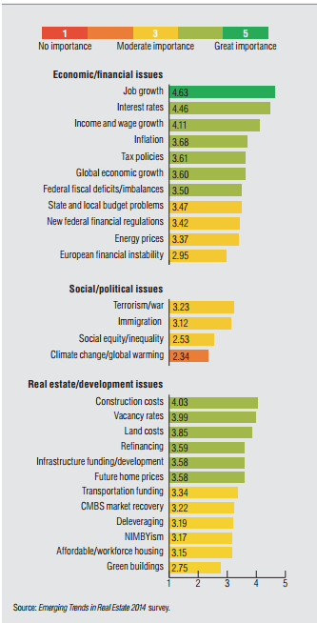
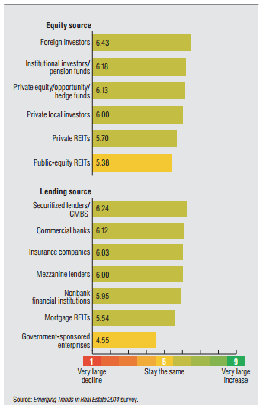
Global Professional Services Industry: Business Trends Key Market Issues in Real Estate
2014 Issues of Importance for Real Estate
Change in Availability of Capital for Real Estate in 2014

Slide 44
Table of Content
Global Professional Services MI
Technology Trends
Disclaimer:
The information presented in this report is based on data available in the public domain. If you find that it is incorrect, please let us know.

Slide 45
Global Professional Services Industry: IT Trends Hot IT Implementation Trends in Accountancy Services
Improved productivity
Investment in IT has been identified as a key driver of productivity improvement among public accounting firms. IT enables public accounting firms to automate their routine auditing tasks and improve work collaboration and communication within audit teams, which in turn may enhance their service delivery
Improved Accuracy
Accounting work is very detailed and accuracy in recording and reporting is greatly valued. Technology has had a positive effect in accounting applications because calculations done by a computer program experience very few errors.
Data Mining Tools
Data mining tools are critical within accounting firms, as they enable firms to respond immediately to changes in the economic and regulatory environment.
Web-Based Alert Tools
Web-based alert tools notify firms immediately when there are any regulatory changes. Most importantly, firms will be able to change the settings so that the filter will notify them only of changes that effect their specific practice areas.
Major Role of IT in Accounting
To put information close to accountants .
To improve the capacity of accounting research and extension specialists to organize , store , retrieve and accounting information exchange .
To evolve mechanism of information sharing .
To develop accounting database for easy access and data base decision making .
Access to the storehouse of information is easy.
accounting data will available universally .
One accountant can deal with various companies through effective utilization of IT in accounting .
- 45 -
- 45 -
Notes:
Sources:
http://changeharbour.com/index.php/2011/07/11/trends/
http://www.svtuition.org/2009/10/role-of-information-technology-in.html
http://smallbusiness.chron.com/effectiveness-information-technology-accounting-applications-2102.html
http://www.ehow.com/about_6300998_emerging-technology-accounting.html

Slide 46
Global Professional Services Industry: IT Trends Analytics in Accountancy Services
Traditional tools and analytics may be inadequate for a holistic and progressive view of the market and the organization in real-time. CFOs need to move toward a more proactive use of information to drive business outcomes. They need to re-think their use of data and the investments they make in analytics. Smarter analytics and decision-making support from the right partner can propel the firm toward growth.
Implementing advanced analytics solutions leads to positive business outcomes such as the following:
Revenue assurance: Assure revenue by reducing billing leakage and predicting credit risk.
Increased revenue: Realize hidden revenue, identify opportunities, increase cross or up-selling and diversify product streams.
Improved operating margins and expenses: Identify and eliminate bottlenecks, improve efficiencies, minimize waste and ensure contract compliance.
Improved working capital: Optimize inventory and logistics for better cash flow.
Improved financial control and agility: Reduce financial risk, enhance statement quality and regulatory compliance performance, make decisions quickly and adapt faster to market changes.
Benefits
Better analytics provide CFOs with insights into their business and enable them to take data-driven decisions to stay ahead of the competition. Analyzing the business environment accurately and taking strategic and timely decisions are essential to unlocking an organization’s growth potential and becoming a market leader.
CFOs need visibility and transparency across the entire organization to highlight improvement opportunities and meet business objectives. They also need to meet the challenges of the current market and regulatory environments. The investment they make in analytics assumes greater importance in this scenario.
CFOs have the choice of building an in-house analytics team or partnering with a capable business process service provider. Such partnering allows businesses to focus on core activities with the assurance that an important activity that supports business decision-making is being well-executed.
Organizational perspective
Notes:
http://www.tcs.com/resources/white_papers/Pages/Analytics-Finance-Accounting.aspx

Slide 47
Global Professional Services Industry: IT Trends Hot IT Implementation Trends in Legal Services
Critical Drivers of IT Adoption in Legal Services:
Recession: Many law firms have thrived during downturn due to their particular practice areas of functioning, while others suffered heavily.
Technology-led commoditization of legal services. The ability to assemble ever more sophisticated legal documents automatically means that many of legal sector’s traditional revenue sources are under constant price pressure.
Increasing use of fixed fees for certain categories of legal work. Once a fee is fixed, the firm’s profit depends on its ability to provide services cost effectively.
Growing technological sophistication of clients. Not only are they increasingly concerned with the way in which their information is handled by their law firms, clients are also demanding instant access to both documents and lawyers.
Big Data
The industry is full of transaction-based processes — from service of process to trademark filings to legal billing invoices. There are opportunities for the legal industry to responsibly leverage the data that is a by-product of these transactions to improve decision making and streamline operations.
Social Media
Leaders at several top 100 firms are for the first time hiring full-time social media specialists to manage firms’ LinkedIn, YouTube and Twitter accounts, and many more are making a concerted effort to prioritize social media outreach in marketing campaigns. Now firms are learning to sell themselves in more indirect ways — such as urging attorneys to blog about new regulations or court cases they’re not personally involved in
Mobile Apps
Mobile apps and devices are quickly becoming the life blood of law firms. Firms want to give their lawyers the tools they need to do their jobs most effectively and productively.
Competition, commoditization and client sophistication are forcing law firms to pursue technology-driven efficiencies.
The legal software sector has not seen the same supplier consolidation that has defined the mainstream enterprise applications business in the past ten years, which means that vendors and their products are still arranged in functional silos. This in turn means that law firms’ information assets are often similarly siloed.
- 47 -
Notes:
Sources:
http://www.forbes.com/sites/ciocentral/2012/06/26/lawyers-embrace-big-data/
http://www.washingtonpost.com/business/capitalbusiness/law-firms-get-into-the-social-media-game/2012/02/29/gIQArYtL5R_story.html
http://www.tmcnet.com/channels/mobile-device-management/articles/305358-mobileirons-mobile-device-management-solution-implemented-law-firms.htm
http://www.information-age.com/channels/information-management/features/1307743/swift-justice.thtml
http://www.globalservicesmedia.com/BPO/Industry-specific-Processes/Legal-Process-Outsourcing-In-The-New-Legal-Services-Landscape/23/29/11112/GS110704609796

Slide 48
Global Professional Services Industry: IT Trends Cloud Services in Law firms
For the legal fraternity, reduced risk is benefit compelling the drive towards the cloud. Disaster Recovery (DR) and business continuity solutions, which reduce risk by ensuring that mission-critical data is safeguarded, are essential for any data-driven environment. Cloud can now be more easily implemented, which is particularly appealing to law firms and legal departments where IT resources and budget are limited. Effective collaboration, enabled by cloud solutions that allow for sharing and co-authoring of files, can also improve attorney productivity and client service.
Key IT issues of legal services industry:
Connectivity is the first critical point, since the availability of the cloud depends on connection to the cloud data centre. Using the services of a cloud provider with replicated data centers in different geographical areas can help to mitigate this risk, since the distance between an organization's gateway and the cloud provider can affect bandwidth latency. In addition, cloud providers that offer incremental service updates and data backup can help to reduce the amount of data that needs to be synchronized with the cloud.
Cloud solutions for the legal industry need to integrate business process, workflow and security to mitigate this risk and safeguard access, data security and integrity.
Data privacy regulations and the implications of the legal domains in which cloud content is stored also need to be considered. For example, many countries do not permit certain types of data, such as personal information, to be stored outside of the country. Even support functions such as system administrator access to data may not be permitted outside the country. This can complicate the cloud environment as many cloud data centers reside in the United States and Europe. Cloud providers need to offer mitigation strategies to address these concerns, and both the provider and the client need to be responsible for ensuring that data is properly safeguarded and processed.
Notes:
http://www.altonet.co.za/index.php/news/press-releases/132-considerations-for-legal-firms-when-migrating-to-the-cloud

Slide 49




Global Professional Services Industry: IT Trends Hot IT Implementation Trends in Legal Services
Collaboration platforms will become social and be based around people rather than documents
Web 2.0 features will shift the emphasis from documents collaboration to facilitating interactions with people. These platforms will make it easier for people to connect based on expertise and areas of interest as well as availability
This technology will build social networks that will help the organization to be more agile and responsive to business changes
Client facing systems and tools will become integrated with internal systems and tools
Information and content that is shared with external parties will be integrated with systems that are used internally.
This capability will allow us to manage end to end legal and business processes in a streamlined and efficient manner
Applications and business processes will go mobile
More powerful devices and faster networks will enable more applications content, features and process to be delivered to multiple devices including home machines, smart-phones, and tablets.
This capability will empower fee earners to be more mobile, use appropriate devices for particular purposes and will support more geographic flexibility for the firm
Tools and techniques will emerge to model and manage legal processes
These tools will enable legal experts to build models
These tools will be critical to allow the effective disaggregation of legal processes which is vital to facilitate effective sourcing planning and decision making for legal work
- 49 -
Notes:
Sources:
http://changeharbour.com/index.php/2011/07/11/trends/

Slide 50
Global Professional Services Industry: IT Trends Hot IT Implementation Trends in HR & Employment Services
Mobile- Mobile phones are convenient, used by billions, and integrated with Facebook and Twitter. The huge demand for mobile services has prompted businesses to develop new ways for customers to interact directly with companies through their phones.
Potential uses for staffing: Develop mobile apps for placing orders, registering company service, viewing top candidate profiles or searching available jobs.
Social Media. As more consumers use social media to both recommend and complain about service, staffing and recruiting companies need to develop more effective response methods.
Potential uses for staffing: Beyond merely pushing content to social media, use it as true two-way customer service resolution channels. Develop social media standard operating procedures to solve complaints.
Big Data
“Social recruiting” is on the rise thanks to the technological advancement. Along with this trend comes huge data and information which will come along with new ways of finding, relating to, and securing talent. Fueled by the emergence of social and mobile recruiting, many companies now receive more than 100 applicants for a given position, and 68 percent of employers report that more than half of those candidates are not qualified for the position, according to the Talent Board’s Candidate Experience Report The sourcing and recruitment will become much more data driven and the staffing firms will be looking for solution that optimizes their search for the talent from the “Big Data”.
- 50 -
Notes:
Sources:
http://www.staffingtalk.com/staffing-industry-trends-2012-expert-predictions/
http://new.hirevue.com/company/news/hirevue-secures-22-million-to-modernize-and-reinvent-the-recruiting-process/
http://www.staffingindustry.com/Research-Publications/Blogs/Andrew-Karpie-s-Blog/Staffing-Firms-and-Technology-in-2012-Challenging-Staffing-Firms-At-Their-Own-Game

Slide 51
Global Professional Services Industry: IT Trends Hot IT Implementation Trends in HR & Employment Services
Online/video interviews may now be the most “visible” and hottest area in Talent Acquisition Technology (TAT) environnent
It may also be a broader, new-entrant e-Platform that joins “major platform businesses” like LinkedIn and oDesk, that have the potential to absorb and reengineer large segments of staffing industry “value-added processing.”
Many staffing firms have already started down this path –perhaps without realizing it—by deploying VOIP/integrated telephony, maybe integrating it with some other systems. But probably most have not really thought explicitly about the problem from a UC perspective
Many communications vendors and even software vendors, such as Microsoft, have been pushing to make UC available to smaller and midsized firms
The future of cloud-based technology in human resource management is very bright. Today huge database of employees and clients are managed in one click. Also the recruiters can now easily short list the candidates online and out of office. The cloud boom has changed the whole scenario of an organization in terms of automatic generation of attendance, payrolls, salary slip, income tax and provident funds, thus providing 360 degree umbrella to the HR Department.
The manual work in the organizations is now shifted to soft copies. The chances of errors are considerably negligible Administration becomes very smooth as the whole management system can be accessed easily away from office as well. And hence the managerial activities do not get hampered. Also it is easy to integrate among different offices at different locations.
Notes:
Sources:
http://articles.timesofindia.indiatimes.com/2013-08-12/services-apps/41376000_1_erp-implementation-hr-managers-implementation-process
http://www.staffingindustry.com/Research-Publications/Blogs/Andrew-Karpie-s-Blog/Staffing-Firms-and-Technology-in-2012-Challenging-Staffing-Firms-At-Their-Own-Game

Slide 52
Global Professional Services Industry: IT Trends IT Implementation Trends in HR & Employment Services: Big Data
Applying Big data to recruiting — also referred to as people analytics — is not only fueling businesses' search for the best candidates, but also delivering a healthy dose of entrepreneurial energy to HR. Firms such as Riviera Partners, Gild, TalentBin and others are providing companies with products designed to draw closely aligned candidates from the big-data well.
A recent whitepaper published by eQuest points out that for human resources in particular, big data marks an "historic opportunity" to make the "most rigorously evidence-based human-capital decisions ever.“
"Newbie recruiters were sent to a closet of filing cabinets where we mined paper files to gather contacts for our call lists," says Catherine Reynolds, owner of OnBoard Recruitment Advisers, in a post on Simplicity 2.0. She adds that, today, this is no longer the case. "Instead of mining data in the closet, we have open access to information through sites such as LinkedIn.“
Recruiting is — at its core — storytelling, says Reynolds. And while she says she embraces big data's advancing role in candidate searches, she adds that it sometimes takes a recruiter's call to fully engage a candidate in an opportunity.
Expert Speak
Xerox recently cut the attrition rate at its call centers by 20% by using big-data tools to staff its 48,700-person department. And, in a single six-month trial period, Xerox was so impressed by the outcome that it decided to keep using big data to hire new employees for the center going forward.
Manpower improved its performance management system with IBM Cognos & Planning and IBM Cognos 8 BI
Real Life implementation
Notes:
http://mashable.com/2014/06/11/big-data-recruiting/

Slide 53
Global Professional Services Industry: IT Trends
Hot IT Implementation Trends in Real Estate Advisory Services Firms
Commercial Real Estate: Bringing information technology onto the construction site
Traditionally, building design and construction has relied solely on two-dimensional printed drawings to represent the work that needs to be completed by field personnel.
Within the last few years, however, contractors have implemented technology that enables project teams to obtain information electronically
This shift from printed to electronic planning allows companies to identify and resolve issues more quickly, allowing for more time to innovate and focus on broader project deliverables
Real estate companies deploy iPods and the cloud
2012- Brisbane-based real estate agency, First Commercial Realty, is the latest commercial real estate firm to equip its entire sales force with iPods and the Surge Central cloud-based CRM software application from Adept Business Systems.
In addition to managing contacts and property listings real estate agents could capture requirements to lease or purchase real estate, add notes and generate property marketing brochures - without the need to involve administrators
- 53 -
Notes:
Source:
http://www.bizjournals.com/seattle/print-edition/2012/06/29/commercial-real-estate-bringing.html?page=all
http://www.itwire.com/cloud-computing/55878-real-estate-companies-deploy-ipads-and-the-cloud-with-surga-central

Slide 54
Global Professional Services Industry: IT Trends
Hot IT Implementation Trends in Real Estate Firms: Case Study
CBRE Group: Implementation of CRM; SaaS & PaaS
CB Richard Ellis deployed Salesforce CRM SFA and the Force.com to create ‘Proflo’, a multi-tenant Software as a Service (SaaS) program management platform which helped real estate teams and program managers deliver programs globally in a compliant, consistent manner. CBRE received a 20-fold return on its investment in Salesforce CRM and the Force.com every year Salesforce―through Proflo― helped reduce project administration and management significantly, with the volume of paperwork falling by 50%
RioCan: Use of Mobility to engage Customers
Rogers Communications launched Mobile Shopper, a machine-to-machine (M2M) solution that enabled customers to engage with brands in-store through mobile offers, applications and mobile payments technology all with their smartphone
RioCan rolled out Rogers Mobile Shopper solution in its selective Ontario-based shopping centers as part of testing

Slide 55
Table of Content
Global Professional Services MI
Top Players
Disclaimer:
The information presented in this report is based on data available in the public domain. If you find that it is incorrect, please let us know.

Slide 56
Global Professional Services Industry: Top Players
Legal Firms
Law Firm | Latest Reported Revenue(in Billion $) | Head Quarters
Baker & McKenzie | 2.41 | US
Skadden, Arps, Slate, Meagher & Flom | 2.32 | US
Norton Rose Fulbright | 2.09 | UK
Linklaters | 1.94 | UK
Freshfields Bruckhaus Deringer | 1.93 | UK
Freshfields Bruckhaus Deringer | 1.93 | UK
Clifford Chance | 1.87 | UK
Latham & Watkins | 1.82 | US
Hogan Lovells | 1.71 | UK
Jones Day | 1.52 | US
Kirkland & Ellis | 1.428 | US
Notes:
http://en.wikipedia.org/wiki/List_of_100_largest_law_firms_by_revenue

Slide 57
Global Professional Services Industry: Top Players
Audit Firms
Audit Firm | Latest Reported Revenue(in Billion $) | Head Quarters
Deloitte | 34.2 | US
PwC | 34 | UK
Ernst & Young | 27.4 | UK
KPMG | 23.4 | Netherlands

Slide 58
Global Professional Services Industry: Top Players
Employment Firms
Employment Firm | Latest Reported Revenue(in Billion $) | Head Quarters
Adecco SA | 25.89 | Switzerland
Randstad | 21.995 | Netherlands
Manpower | 4.49 | US
Allegis Group, Inc. | 4.4 | US

Slide 59

Send your feedback / suggestions to the analyst team:
sutirtha.sen@tcs.com
d.basak@tcs.com

